Slide 1
Многопоточность в .NET
Контур.Шпора 2021
Плотников Константин
Титаренко Дмитрий

Slide 2
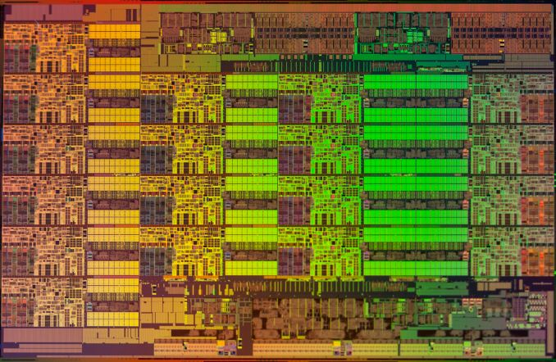
Зачем все это нужно
Intel Haswell-EP Xeon E5-2699 V3 (18 physical cores)

Slide 3
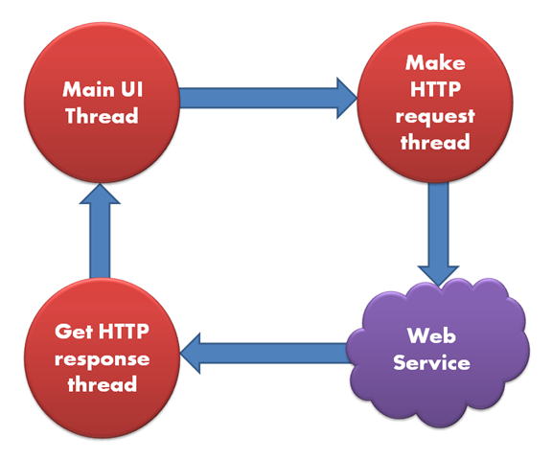
Зачем все это нужно (2)
Рендеринг интерфейса
графического приложения
не должен зависать

Slide 4
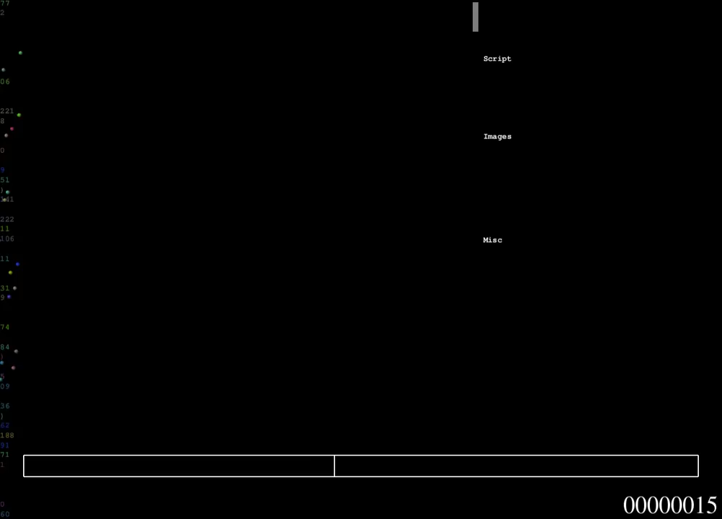

Slide 5
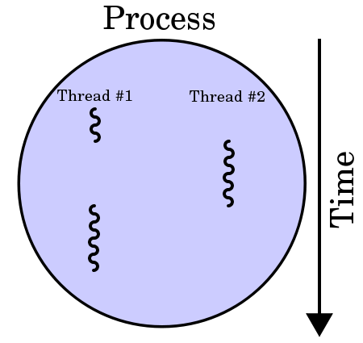
Процесс
Экземпляр исполняемого файла
Ресурсы:
Виртуальная память (код, данные)
Handles (сетевые сокеты, открытые файлы, …)
Security tokens
Переменные окружения
Внутри 1+ поток выполнения
Priority class
Affinity

Slide 6
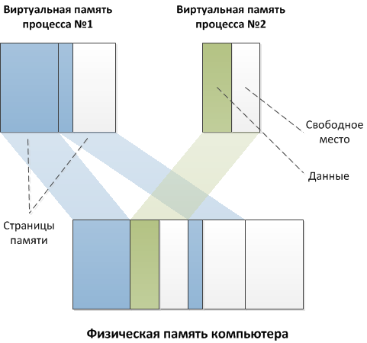
Процесс (2)

Slide 7
Поток выполнения (Thread)
Самостоятельная последовательность инструкций
Ресурсы процесса общие между всеми его потоками
Объект, управляемый планировщиком ОС
Свой контекст (стек, значения в регистрах)
Priority level
=> Base Priority = F(Priority Class, Priority Level)
Разделяет процессорное время со всеми остальными потоками ОС
Affinity

Slide 8
Многозадачность
Кооперативная
Каждый поток сам заботится о том, чтобы отдавать процессорное время другим
За рамками рассмотрения:
UMS (User-mode scheduling) threads
fibers
Вытесняющая
Специальный планировщик ОС принудительно переключает ядра процессора между потоками с учетом приоритетов

Slide 9
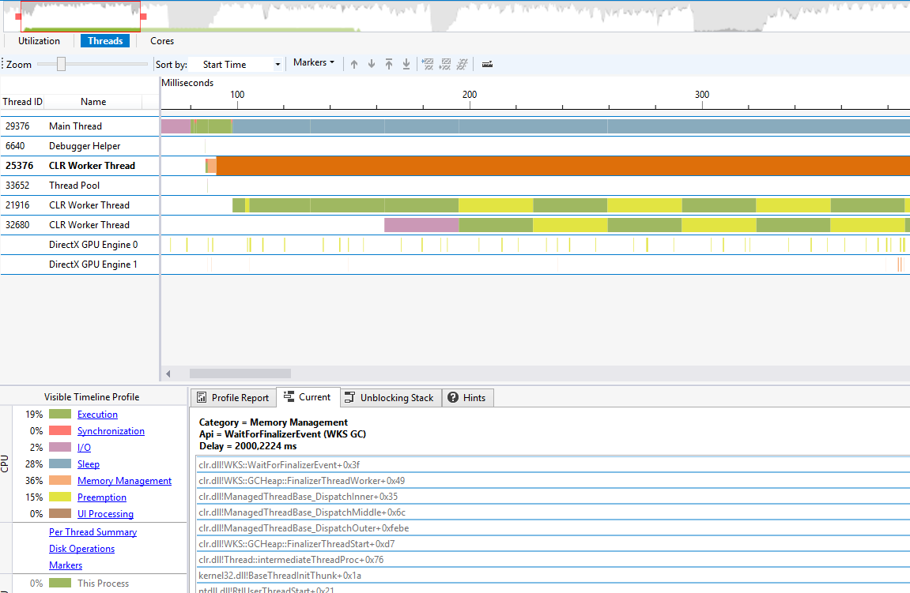
Вытесняющая многозадачность

Slide 10
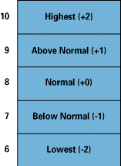
Приоритеты потоков
Base Priority = F(Priority Class, Priority Level)
0 – idle
1..15 – dynamic
16..31 - realtime
Дополнительные Priority Levels:
idle => в минимум
time-critical => в максимум

Slide 11
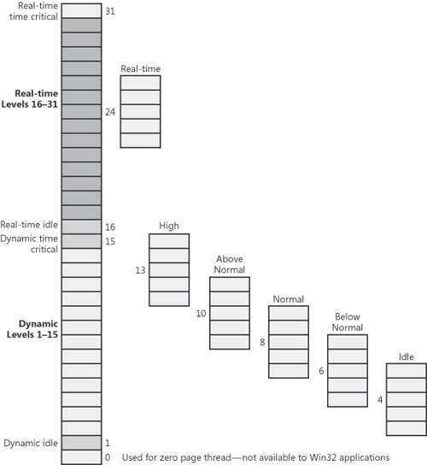
Приоритеты потоков (2)

Slide 12
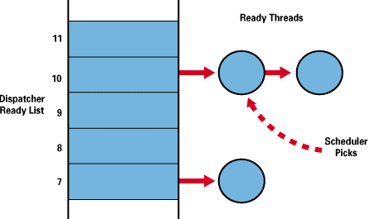
Планировщик потоков
Quantum (time slice) ~30ms или ~200ms
Переключение контекста возможно:
Закончился квант
Поток ожидает события (блокировка/IO/..)
Появился более высокоприоритетный поток

Slide 13
Планировщик потоков (2)
Dynamic Priority
Boosting
Событие клавиатуры/мыши
Выход из состояния Wait
Окошко стало активным
Поток ~3-4 сек. не получал квант времени
сразу до приоритета 15
увеличивается длина кванта
Не применяется для RealTime
Выдается временно: очередной квант => -1 к приоритету и так до Base

Slide 14
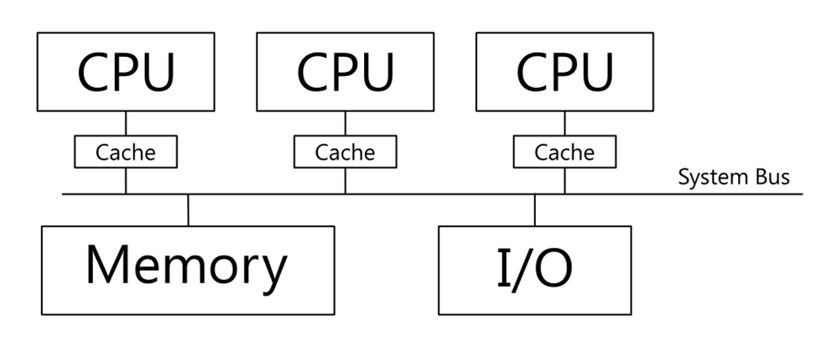
Multicore

Slide 15
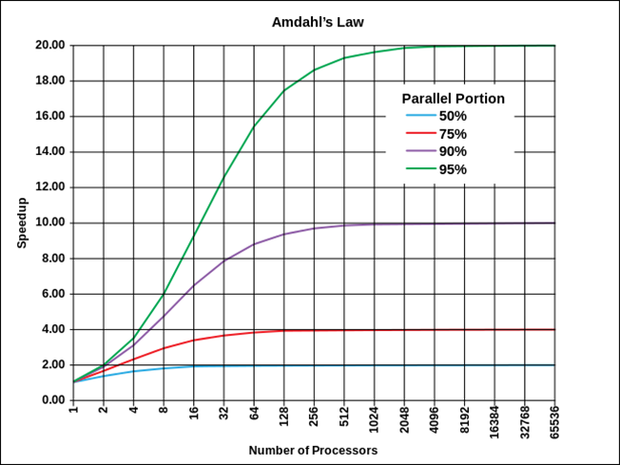
Закон Амдала

Slide 16
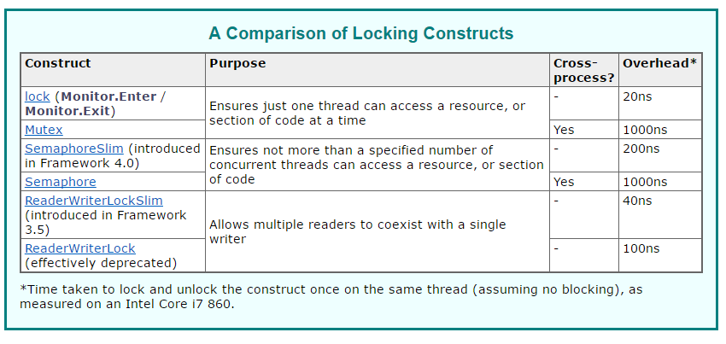
Примитивы синхронизации

Slide 17
Monitor и lock
var lockObj = new Object();
bool lockTaken = false;
try
{
Monitor.Enter(lockObj, ref lockTaken);
// Our code
}
finally
{
// Ensure that the lock is released.
if(lockTaken)
{
Monitor.Exit(lockObj);
}
}

Slide 18
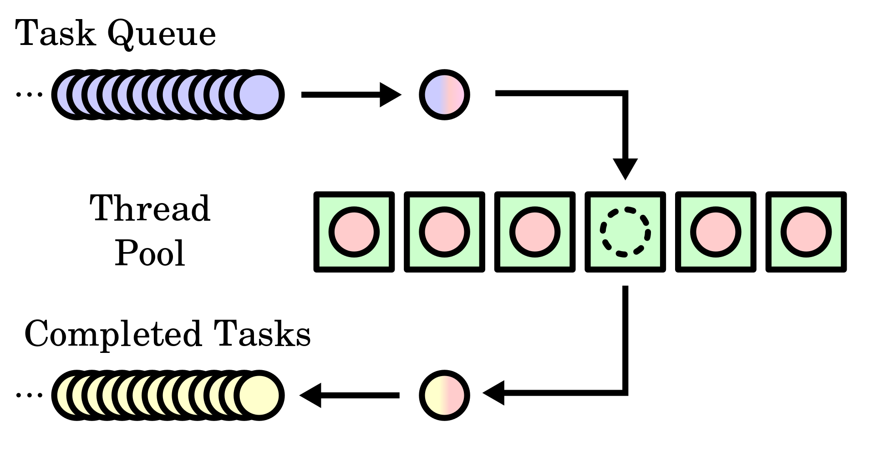
Thread Pool

Slide 19
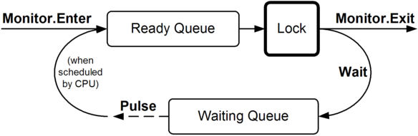
Monitor .Pulse и .Wait

Slide 20
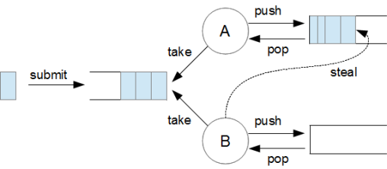
Thread Pool .NET 4.0

Slide 21
Thread Pool .NET 4.0
.SetMinThreads()
.SetMaxThreads()
max
threads
min
time

Slide 22
Data parallelism
Parallel LINQ (PLINQ)
Parallel class
Parallel.Invoke
Parallel.ForEach
Parallel.For
Notes:
There are two strategies for partitioning work among threads: data parallelism and task parallelism.
When a set of tasks must be performed on many data values, we can parallelize by having each thread perform the (same) set of tasks on a subset of values. This is called data parallelism because we are partitioning the data between threads. In contrast, with task parallelism we partition the tasks; in other words, we have each thread perform a different task.
In general, data parallelism is easier and scales better to highly parallel hardware, because it reduces or eliminates shared data (thereby reducing contention and thread-safety issues). Also, data parallelism leverages the fact that there are often more data values than discrete tasks, increasing the parallelism potential.
PLINQ offers the richest functionality: it automates all the steps of parallelization — including partitioning the work into tasks, executing those tasks on threads, and collating the results into a single output sequence. It’s called declarative — because you simply declare that you want to parallelize your work (which you structure as a LINQ query), and let the Framework take care of the implementation details. In contrast, the other approaches are imperative, in that you need to explicitly write code to partition or collate. In the case of the Parallel class, you must collate results yourself
Parallel vs PLINQ:
https://m.habr.com/ru/post/135942/
https://download.microsoft.com/download/B/C/F/BCFD4868-1354-45E3-B71B-B851CD78733D/WhenToUseParallelForEachOrPLINQ.pdf

Slide 23
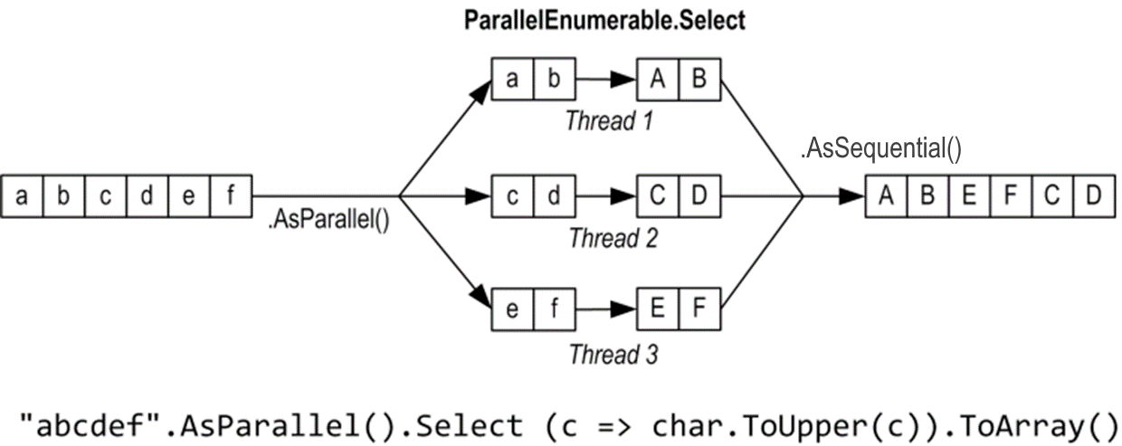
PLINQ
.AsParallel()
.AsSequential()
Notes:
AsParallel - магия! IEnumerable<T> превращается в ParallelQuery<T>
PLINQ will always attempt to execute a query at least as fast as the query would run sequentially. Although PLINQ does not look at how computationally expensive the user delegates are, or how big the input source is, it does look for certain query "shapes." Specifically, it looks for query operators or combinations of operators that typically cause a query to execute more slowly in parallel mode. When it finds such shapes, PLINQ by default falls back to sequential mode.
The following list describes the query shapes that PLINQ by default will execute in sequential mode:
Queries that contain a Select, indexed Where, indexed SelectMany, or ElementAt clause after an ordering or filtering operator that has removed or rearranged original indices.
Queries that contain a Take, TakeWhile, Skip, SkipWhile operator and where indices in the source sequence are not in the original order.
Queries that contain Zip or SequenceEquals, unless one of the data sources has an originally ordered index and the other data source is indexable (i.e. an array or IList(T)).
Queries that contain Concat, unless it is applied to indexable data sources.
Queries that contain Reverse, unless applied to an indexable data source.
https://docs.microsoft.com/en-us/dotnet/standard/parallel-programming/understanding-speedup-in-plinq?redirectedfrom=MSDN

Slide 24
Concurrency
. WithExecutionMode()
ParallelExecutionMode.ForceParallelism
.WithDegreeOfParallelism()
1..N=512
Notes:
Degree of parallelism is the maximum number of concurrently executing tasks that will be used to process the query.
Motivation, SetMinThreads matters

Slide 25
Order
.AsOrdered()
Order
Deterministic output for some operators
Performance degrading
.AsUnordered()
Notes:
It must keep track of the original ordering throughout the partitions and at merge time ensure that the ordering is consistent. Therefore, we recommend that you use AsOrdered only when it is required, and only for those parts of the query that require it. When order preservation is no longer required, use AsUnordered to turn it off.
Note that PLINQ preserves the ordering of a sequence produced by order-imposing operators for the rest of the query. In other words, operators such as OrderBy and ThenBy are treated as if they were followed by a call to AsOrdered.
The following PLINQ query operators may in some cases require ordered source sequences to produce correct results:
Reverse, SequenceEqual, TakeWhile, SkipWhile, Zip
Some operators output is non-deterministic on unordered source, and some adds additional requirements (such as commutability and associativity) on items.
https://docs.microsoft.com/en-us/dotnet/standard/parallel-programming/order-preservation-in-plinq

Slide 26
Buffering
.WithMergeOptions()
AutoBuffered
NotBuffered
FullyBuffered
.WithCancellation()

Slide 27



Partitioning
Range
Chunk
Hash
Indexible data sources
General purpose
For compare operators (Join, GroupBy, Distinct, Except, …)
Notes:
https://devblogs.microsoft.com/pfxteam/partitioning-in-plinq/
https://docs.microsoft.com/en-us/dotnet/standard/parallel-programming/custom-partitioners-for-plinq-and-tpl
1. Range Partitioning – This is a pretty common partitioning scheme, but it only works with indexible data sources such as lists and arrays. The benefits of these data sources is that we know the exact length and can access any of the elements within the arrays directly. For the majority of cases, there are large performance benefits to using this type of partitioning. 2. Chunk Partitioning – This is a general purpose partitioning scheme that works for any data source, and is the main partitioning type for non-indexible data sources. In this scheme, worker threads request data, and it is served up to the thread in chunks. IEnumerables and IEnumerable<T>s do not have fixed Count properties (there is a LINQ extension method for this, but that is not the same), so there’s no way to know when or if the data source will enumerate completely. Another important optimization is that chunk partitioning balances the load among cores, as the tasks per core dynamically request more work as needed. This ensures that all cores are utilized throughout the query and can all cross the finish line at the same time vs. a ragged, sequential entry to the end. 3. Hash Partitioning – Hash partitioning is a special type of partitioning that is used by the query operators that must compare data elements (these operators are: Join, GroupJoin, GroupBy, Distinct, Except, Union, Intersect). All of the data is processed and channeled to threads such that items with identical hash-codes will be handled by the same thread. This hash-partitioning work is costly, but it means that all the comparison work can then be performed without further synchronization. There’s a lot going on with hash-partitioning, so it’s not as speedy as the other types, especially when ordering is involved in the query. 4. Striped Partitioning – This scheme is used for SkipWhile and TakeWhile and is optimized for processing items at the head of a data source (which obviously suits the needs of SkipWhile and TakeWhile). A useful feature of this scheme is that there is no inter-thread synchronization required as each worker thread can determine its data via simple arithmetic. This is really a special case of range partitioning and only works on arrays and types that implement IList<T>.

Slide 28
HowTo Data Parallelism
Число ядер CPU > 1 :)
Функциональная чистота (нет сайд-эффектов)
Отсутствие блокировок (распараллеливаемость)
Делегаты не слишком мелкие (вычислительная сложность не превышает накладные расходы)
Сохранение порядка может убить производительность
Notes:
https://docs.microsoft.com/en-us/dotnet/standard/parallel-programming/understanding-speedup-in-plinq

